Slide 1



Team 4 -COOL NAME TBD
Nandini
Kelly
Chad
Raji

Slide 2
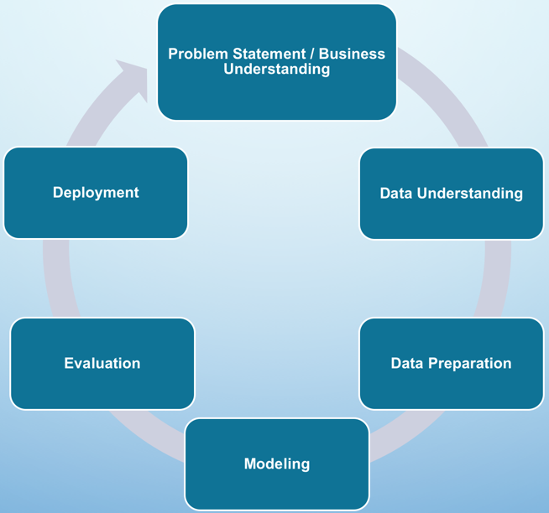
Project Approach
Methods, Practices:
Problem Statement / Business Understanding
How team divides & conquers:
Maximize re-use (ex., instead of everyone analyzing / cleaning, do mostly after merge; Exercises Unit 2)
Data Understanding
Determine which Data
Determine which Columns
Data Preparation
Formatting / Data type conversion before merge
Clean data after merge (most – NaN, duplicates), except dates
Future
GIS data – Area?
School District / Tax (Licking, Morrow, Hocking, Franklin)
Neighborhood Codes
Remove ValidSale = NO (ex., Morrow has NO for 100 rows)
Beautification of visualizations (ex., formatting sales amounts)
Methodology: CRISP-DM
Divide up counties
Review Lab description together and gain common understanding
Modeling
Experiment with visualizations
Communication: Rocket.Chat
Dev Platform: Local (not Amazon Workspace)
GitHub.com
Well-documented notebooks

Slide 3
Problem Statement
Understand How number of rooms impact sales price on home sales
Understanding Land Use across counties
Ex., Is FRANKLIN more rural or agricultural?
Determine if we can explain trends in the housing market with knowledge of events or other aspects that would influence the data
Which county has more sales of newer builds (FUTURE)

Slide 4
Data Understanding
Use head() and view .cvs files to analyze content
Determine which Columns – manual analysis (next slide)
TEAM DECISION: All common fields & those that are mostly common
columns.tolist() to see column names
Some were an easy match
When column names were not obvious

Slide 5
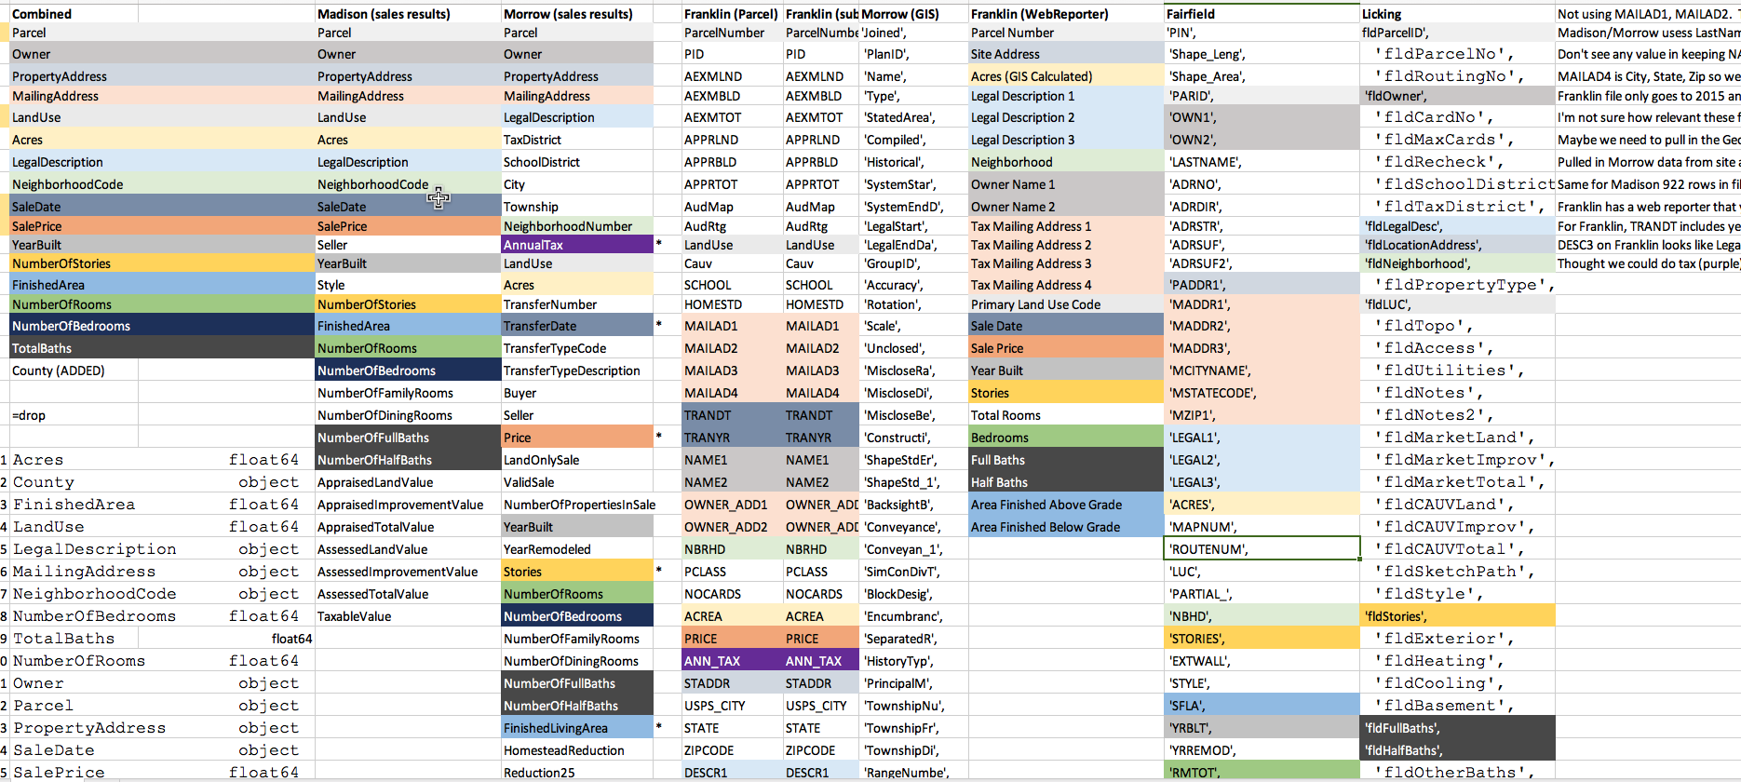
COLUMN DATA ANALYSIS - MANUAL

Slide 6
Data CHALLENGES
Data not complete
Data not aligned on dates
APPROACH: get data from county auditor site (Morrow, Madison, Franklin)
Extraneous, duplicate & split out columns
Ex., only 86 / 156 recs for Madison/Morrow
APPROACH:
Ex., Franklin was old <=2015
Missing / inconsistent data
Ex., Missing LandUse
APPROACH: Where column were present in most files, we kept and filled with NA
Combined (ex., TotalBaths, address fields)
Manual examination to determine which columns to ignore
Dropped (ex., unnamed:27)

Slide 7
Data PREPARATION
Check for Duplicates (post-merge)
Check for NaN
APPROACH: Eliminate (some)
Make sure dtypes aligned (pre-merge)
APPROACH: Eliminate
Format dates MM/DD/YYYY (pre-merge)
Analyze data values post-merge (VALUES_COUNT(), UNIQUE()); view Excel csv file

Slide 8
Data Modeling
Validate Anomalies
Explore other visualizations
pair plots
Number of rooms vs. sales price
Land Use by County

Slide 9
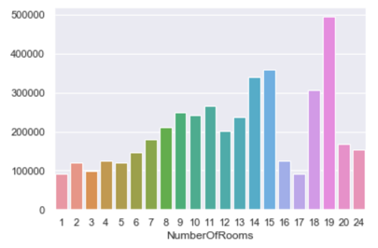
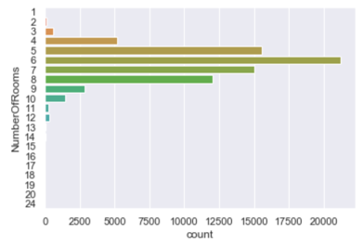
number of rooms Vs sales price
There is a general upward trend in sales price as the number of rooms increase. However, note that properties with >12 rooms have very few data points.
What’s this?
Problem Statement: Understand How number of rooms impact sales price on home sales

Slide 10
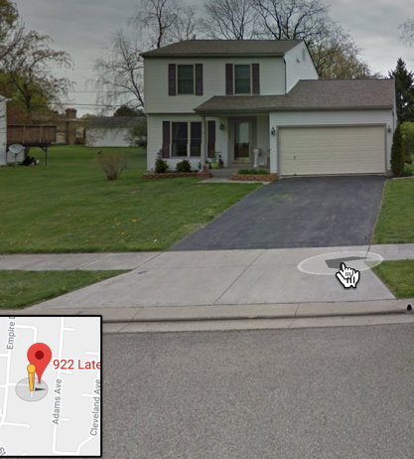
Verifying anomalies
17 rooms took a dip in price
In looking at our merged file, only 2 properties had 17 rooms that had sale prices. Viewed Land Use:
One was an apartment building in Newark
One was residential @$96.5k. Is this the bates motel?
Google search on address…We don’t think this house has 17 rooms
VERIFIED HUNCH: with the larger number of rooms having few data points, we cannot rely on the accuracy of the trend results for rooms > 12
May want to establish minimum value_counts() and/or exclude specific Land Use CODES

Slide 11
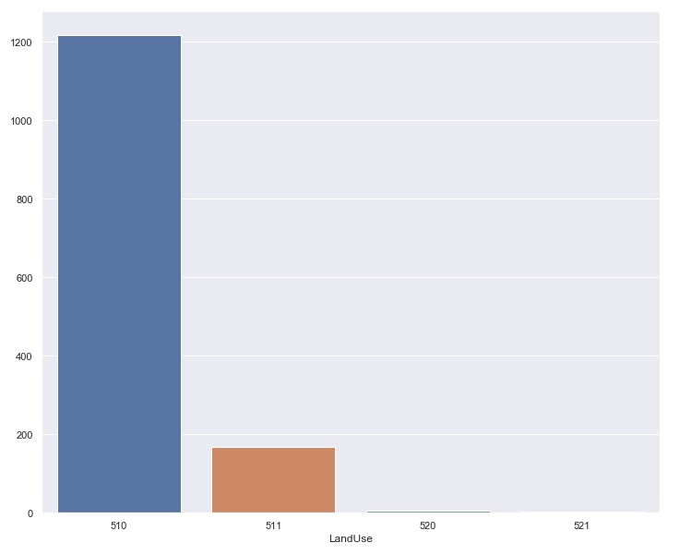
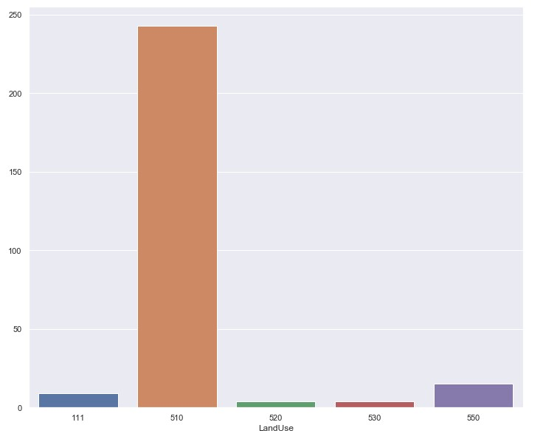
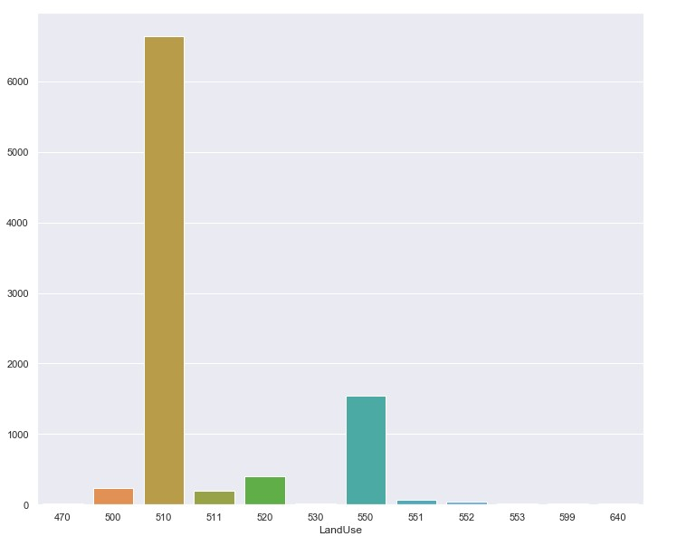
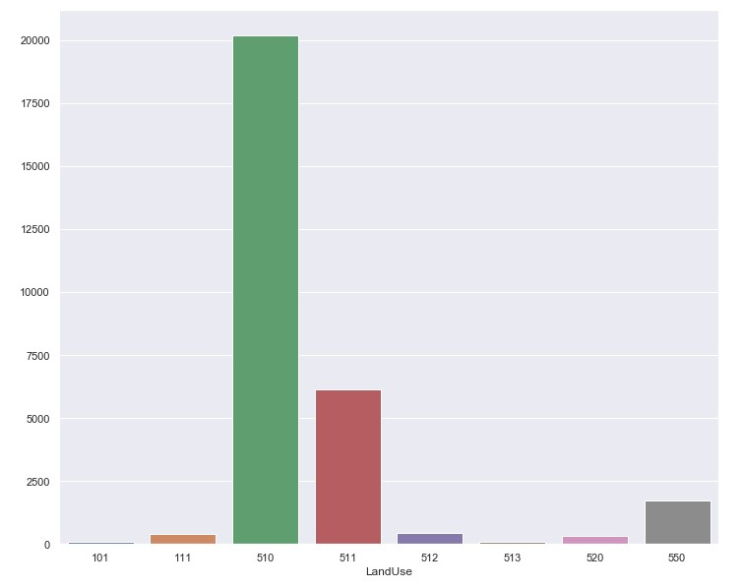
Land Use By County
Pickaway
Madison
ObserVations:
510 (Single Family Dwelling) is the most common across these 4 counties.
550 (Condominium residential unit) is common in franklin, licking and Madison, but not in Pickaway
111 (Cash - grain or general farm "qualified for current agricultural use value"in Madison / Licking*
NOTE: Not looking at counts, just trends (had much more data for Licking than the other counties)
Franklin
Licking
*From 2012 consensus of agriculture (USDA), state rank of total value of ag products sold:
Madison 12
Licking 11
Franklin 63
Pickaway 20

Slide 12

Problem Statement
Understand How number of rooms impact sales price on home sales
Understanding Land Use across counties
Ex., Is FRANKLIN more rural or agricultural?
Determine if we can explain trends in the housing market with knowledge of events or other aspects that would influence the data

Slide 13
FUTURE
Additional data:
GIS data – Area?
School District / Tax (Licking, Morrow, Hocking, Franklin)
Neighborhood Codes
Additional Cleaning
Remove ValidSale = NO (ex., Morrow has NO for 100 rows)
Beautification of visualizations
formatting sales amounts
Enhancing views
Additional analysis
Which county has more sales of newer builds

Slide 14
APPENDIX

Slide 15
To Do -from 6/18 meeting
Morrow/Madison
Combine baths (TotalBaths)
Use current Franklin, Morrow and Madison data files downloaded from sites, 2019 data only
Perry/Pickaway
Break LandUse into codes
Delaware/Hocking
DataCleansing across counties
Ex., date formats
Get Fairfield / Licking data

Slide 16
Approach
Lab Description
Get Data
Franklin County Auditor Data
Sample Franklin County Auditor Data
Madison and Morrow County Auditor Data
Examine Data
Decide which columns are common across counties
Merge the Counties
Create Merge Files for each County
Madison Merge File
Morrow Merge File
Franklin Merge File
Validate Columns for All Merge Files
Merge Files into One (Using APPEND)
Validate All 3 Counties are in the Merged File
Explore Data
Get dtypes for each Column
Describe Data
Get Value Counts
Check for Duplicates
Check for NaN values
Clean Data
Clean Data Approach
Results
Next Steps

